Slide 1

Welcome to Year Six!

Slide 2
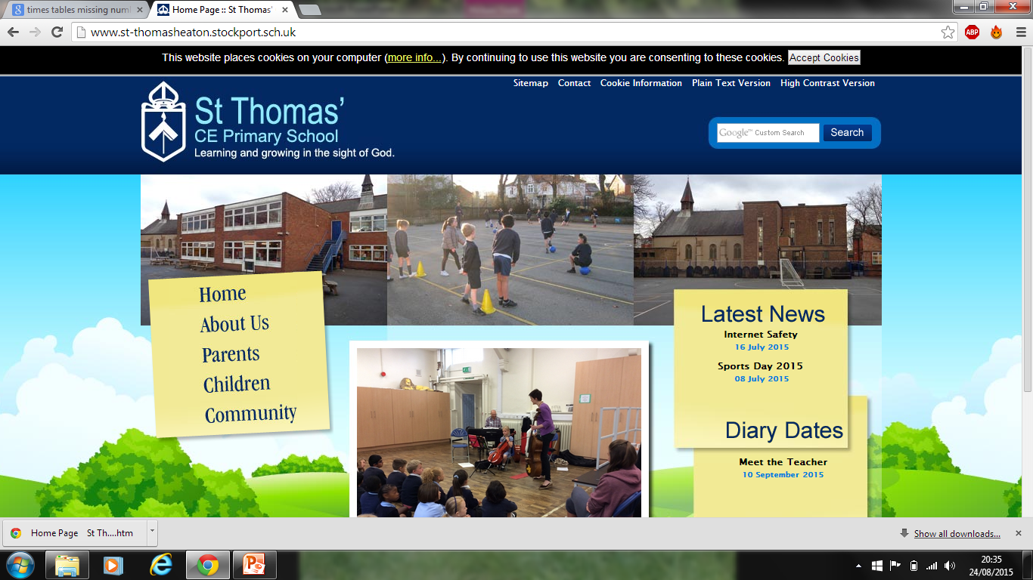
Welcome!
We aim to answer any questions that you may have about our daily timetable and the Year Six curriculum.
Year 6 teachers:
Mrs Armstrong, Miss McGuire and Miss Hughes

Slide 3
Teaching routines:
Mrs Follows and Mrs Gallagher will be our Teaching Assistants for this year, working with groups of children at any time to ensure essential progress is achieved. We also have Mrs Eade working with us 3 days a week across the three classes.
On a Monday afternoon, each class will have an outdoor PE session taught by a sports coach, a music lesson taught by Mrs Walkinshaw or an RE lesson taught by Mr Campen.

Slide 4
Homework
Homework is usually an extension or consolidation of work that has been done in class and in Year 6.
It will become an increasingly valuable tool for revision and SATs preparation.
Maths will be given out on a Tuesday and is due back in on Friday.
English will be given out on Friday and is due back in on a Tuesday.
Please feel free to comment in your child’s reading record on how your child has found the homework tasks.

Slide 5
Reading:
It is essential that children bring their reading books to school each day.
An adult will listen to your child read within a guided reading session each week.
Guided reading will be a taught session and will use a text of a higher level to provide more challenge.
Children will also have the opportunity to change their individual reading books throughout the week.
Please support your child by encouraging them to read on a daily basis, for a minimum of 20 minutes 5 times a week, and signing their Reading Record on a weekly basis.

Slide 6
PE and Games:
Outdoor PE kit is required on a Monday and Thursday (this half term)
Navy shorts or jogging pants
White T-shirt
Navy sweatshirt (No hoods)
Trainers or stronger pumps
No branded clothing
Please ensure your child has the correct PE kit.
Jewellery is NOT permitted to be worn
including earrings!

Slide 7
Communication:
Information will be sent home via e-mail, text, Class Dojo and/or letter.
If you want to speak to your child’s Class Teacher personally or need to discuss a matter at length then please contact school in the usual way to request an appointment at a mutually convenient time.

Slide 8
Online Safety:
Teaching children how to stay safe online is becoming more and more paramount every day. In school we have SMART rules and CEOP posters displayed in every classroom. Children spend their first half term in school learning about online safety in Computing lessons.
Please help support us in educating children about this by implementing rules and regulations at home.

Slide 9
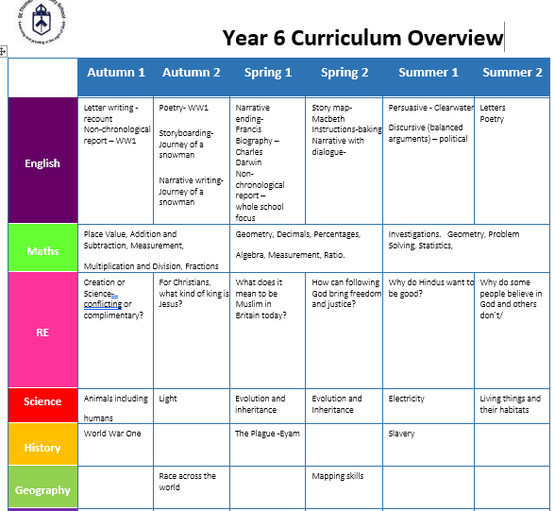

Slide 10
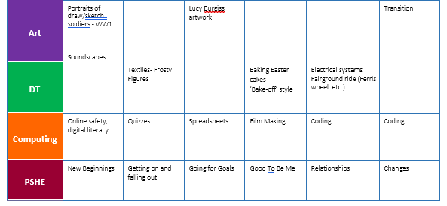
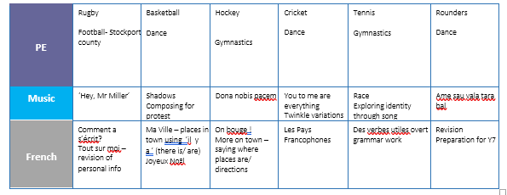

Slide 11
Dates for your Diary:
Y6 Bikeability – Week commencing 8th September (this will last for 3 weeks)
Meet the teacher - Thursday 11th September (4.30-5pm) & Friday 12th September (9-9.30am)
School Council Elections – Week commencing 15th September
Y6 Mock SAT’s – Week commencing 13th October (baseline)
Half Term – 27th October – 31st October
Children return to school – Monday 3rd November
Parents’ Evening Juniors – Week commencing 17th November
Last day of term – Friday 19th December

Slide 12
We look forward to a wonderful year with your children, we will do our best to help them progress as much as possible!
AND HAVE A GREAT TIME!
Thank you for coming.
Are there any questions we can answer?

