Slide 1

Welcome to Year Five!

Slide 2
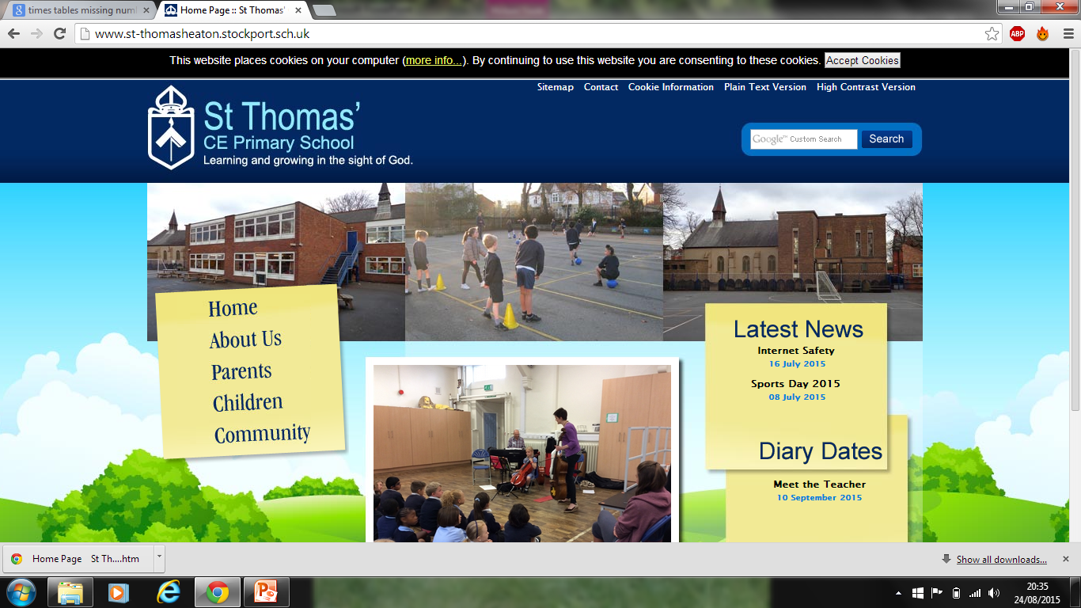
Welcome!
Year 5 teachers:
Miss Grenham, Mrs Leung, Mrs Galbraith
& Mr Bleasdale

Slide 3
Teaching routines:
Mrs Gallagher and Miss Emanuel will be our teaching assistants this year, working with a group of children at a time to ensure essential progress is achieved.
The class will have Music lessons taught by Mrs Walkinshaw, Games lessons taught by Mr Beeley and RE lessons taught by Mr Campen. These will be on Tuesday afternoons.

Slide 4
Curriculum:
Your children will be assessed against age related expectations. These are known as “AREs.”
These can be found on our school year group web page.
Year 5 is the first year of a 2-year UKS2 curriculum in English, and specific AREs have been identified as essential points of progress to work toward this year.

Slide 5
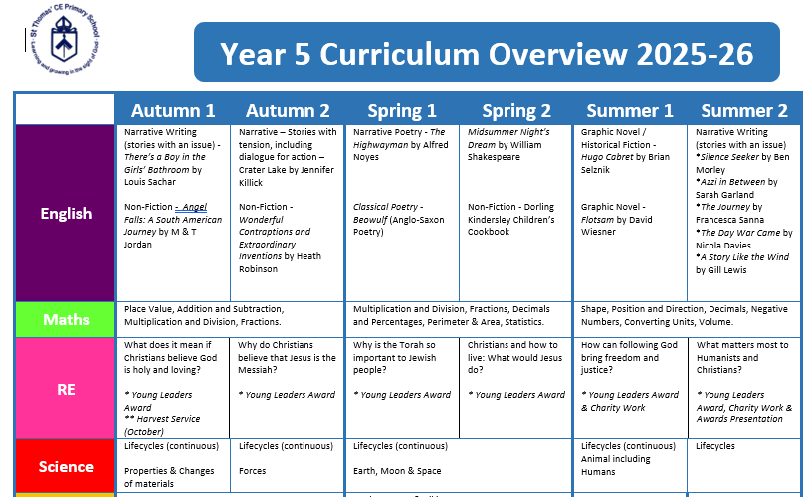

Slide 6
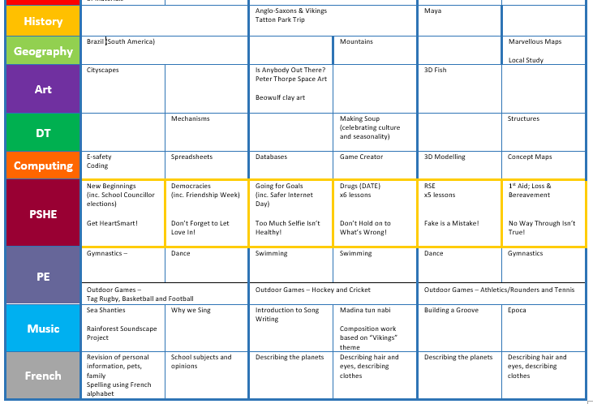

Slide 7
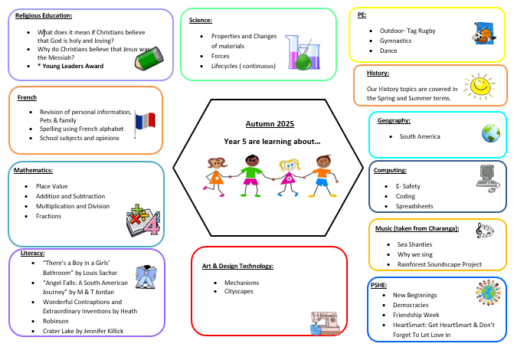

Slide 8
Reading:
It is essential that children bring their reading books to school every day.
Your child will read within a guided reading session each week.
Guided reading will be a taught session and will use a book of a higher level to provide more challenge.
Children will also have the opportunity to change their individual reading books throughout the week.
Please support your child by encouraging them to read on a daily basis for a minimum of 15 minutes and by signing their reading record on a weekly basis.

Slide 9
Homework:
Reading for at least 15 minutes (daily)
Spellings (every other week)
Times tables practice (TTRS can be used for this)
Maths homework weekly (Fri – Wed)
Topic or Young Leader’s homework (Fri – Wed)

Slide 10
Seating:
Children will have set places in the class but these are changed regularly and can also vary according to task.
Changes will be made if necessary, depending on group dynamics.

Slide 11
PE and Games:
Children should come to school wearing their correct outdoor P.E. kit on a Tuesday for 5SB & 5LG and on a Friday for 5YLSG. This should include a lightweight waterproof jacket.
All kit should be clearly named.

Slide 12
Swimming:
Children will participate in weekly swimming lessons, these will occur in the Spring term.
It is essential that children remember their swimming kit for their swimming lesson, otherwise they will not be able to participate.
If your child is unable to swim due to illness, please send a letter addressed to their class teacher but it is usually the case that if they are too ill to swim, they shouldn’t be in school.

Slide 13
Communication:
Information will be sent home via e-mail, text, Class Dojo and/or letter. Look out for the Weekly Bulletin via email.
We also use your child’s Reading Record to communicate personally with you about anything specific to reading, so please check these regularly.
If you need to contact your child’s class teacher, please do so via Class Dojo.

Slide 14
Whole school messages:
Please inform the school office if your child is absent from school or to a PALS arrangement.
If you would like to request time off for your child during term time, you must seek permission from Ms Loynes. Request forms can be found in the office.

Slide 15
Rewards:
To be used as a reward for children’s good behaviour, positive attitude and hard work e.g. dojo points…
Tokens will be given out to pupils seen to be following the ‘St Thomas’ Way’.

Slide 16
We look forward to a wonderful year with your children, we will do our best to help them progress as much as possible!

