Slide 1

St Thomas’ CE Primary School
Welcome to Year Three
Learning and Growing in the sight of God

Slide 2
St Thomas’ CE Primary School
Welcome!
We aim to answer any questions that you may have about our daily timetable and the Year Three curriculum.
Year 3 teachers:
Mrs Shaw, Mr Powell and Miss Watts
Year 4 TAs:
Mrs Solway(Y3VS + Y3HW) and Mrs Potts (Y3MP)
Learning and Growing in the sight of God

Slide 3
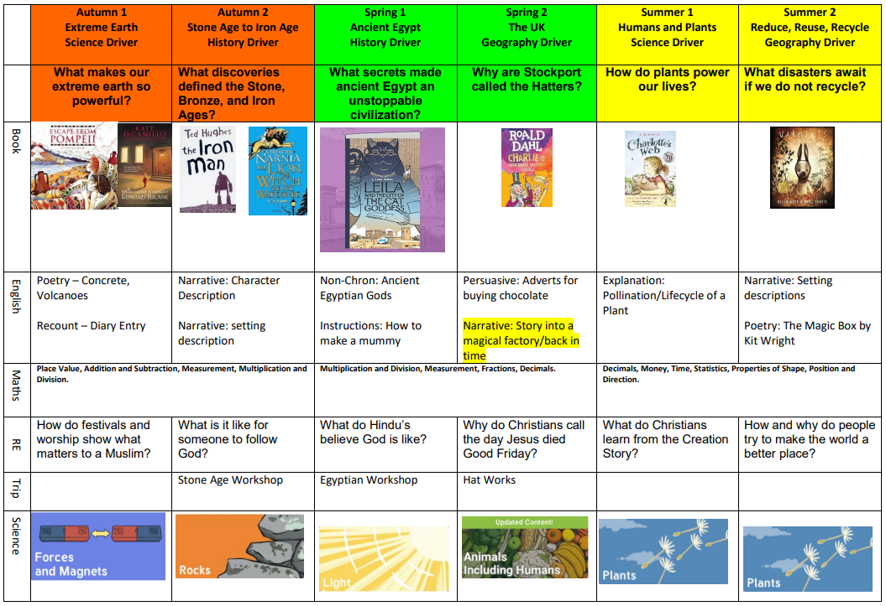
St Thomas’ CE Primary School
Learning and Growing in the sight of God

Slide 4
St Thomas’ CE Primary School
Homework:
Set on Fridays, to be returned/completed on Wednesdays.
Learning and Growing in the sight of God

Slide 5
St Thomas’ CE Primary School
Times Tables
Year 2: x2, x5, x10
Year 3: x3, x4, x8
Year 4: the rest up to x12
Learning and Growing in the sight of God

Slide 6
St Thomas’ CE Primary School
Reading:
It is essential that children bring their reading books to school each day.
The Class Teacher/ Mrs Solway/Mrs Potts will listen to your child read weekly.
Guided reading will be a daily taught session.
Children will be given a new band book once a week – please sign when you hear your child read.
Children will also have a library book – the children can access the school library twice a week.
Please support your child by encouraging them to read on a daily basis. The children should complete the date and pages read in their reading diaries.
Learning and Growing in the sight of God

Slide 7
St Thomas’ CE Primary School
Swimming:
Children will participate in weekly swimming lessons during the Summer Term.
Children with longer hair need to wear a swimming cap. Swim wear should be fitted.
Goggles are not permitted unless there is a medical reason
It is essential that children remember their swimming kit for their swimming lesson. Swimming is not optional.
If your child is unable to swim due to illness, please notify your Class Teacher.
DO NOT get your child’s ears pierced after Easter.
Learning and Growing in the sight of God

Slide 8
St Thomas’ CE Primary School
PPA arrangements:
The class will have RE/Music/Games lessons.
Music by Mrs Walkinshaw
Games lessons are taught by a sports coach.
RE is taught by Mr Campen
These will be on Wednesday afternoons.
Please send your child into school, on that day in their outdoor kit.
Y3VS will have Mrs Walkinshaw on a Thursday morning
Learning and Growing in the sight of God

Slide 9
St Thomas’ CE Primary School
PE and Games:
When your child has Games, they should come to school that day in their outdoor kit.
The children will have indoor PE (dance and gymnastics) during the Autumn and Spring Terms.
Please ensure your child has the correct PE kit.
All kit should be clearly named. Kits will be kept in school at all times and will be sent home at the end of each half term.
Learning and Growing in the sight of God

Slide 10
St Thomas’ CE Primary School
Please ensure your child has the correct kit:
Navy blue shorts
Navy blue jogging pants
White t-shirt
Navy blue sweatshirt or jumper- no hoods or logos
Trainers
Waterproof coat
In winter please ensure that your child is kitted out accordingly.
Learning and Growing in the sight of God

Slide 11
St Thomas’ CE Primary School
Communication:
Information from your class teachers will be sent home Class Dojo, letter of email.
If you want to speak to your child’s Class Teacher personally or need to discuss a matter at length then please phone school or Dojo the class teacher to arrange an appointment.
Learning and Growing in the sight of God

Slide 12
St Thomas’ CE Primary School
General:
Water Bottles need to be in school, labelled.
School bags need to be large enough for an A4 piece of paper, school book-bags are ideal. Lockers are not big enough for PE kits and large rucksacks.
We are a healthy and nut free school.
Learning and Growing in the sight of God

Slide 13
St Thomas’ CE Primary School
Class Dojo:
To be used as a reward for children’s good behaviour.
Can be used to message class teacher with queries/ questions.
Also…
We follow the St Thomas’ Way whereby all staff can reward the children (in and out of the classroom) with a special token.
Learning and Growing in the sight of God

Slide 14
St Thomas’ CE Primary School
Year 3 Events – book the date:
Stone Age Day– Autumn 2, Monday 3rd November
Egyptian Day – Spring 1, Monday 5th January
Easter Service – Monday 23rd March
Visit the HatWorks– Summer 1
Please check the School Weekly Bulletin newsletter for information about School events.
Learning and Growing in the sight of God

Slide 15
St Thomas’ CE Primary School
Holidays:
If you would like to request time off for your child during term time, you must seek permission from Ms Loynes.
Request forms can be found in the office.
Learning and Growing in the sight of God

Slide 16
St Thomas’ CE Primary School
We look forward to a wonderful year with your children.
Thank you for coming.
Are there any questions we can answer?
Learning and Growing in the sight of God

