Slide 1

Welcome to Year Six!
Year 6 Teachers:
Mrs Armstrong, Miss McGuire and Miss Hughes

Slide 2
Teaching routines:
Mrs Follows and Mrs Gallagher will be our Teaching Assistants for this year, working with groups of children at any time to ensure essential progress is achieved. We also have Mrs Eade working with us 3 days a week across the three classes.
On a Monday afternoon, each class will have an outdoor PE session taught by a sports coach, a languages lesson taught by Mrs Galbraith or an RE lesson taught by Mr Campen.

Slide 3
Homework
Homework is usually an extension or consolidation of work that has been done in class and in Year 6.
It will become an increasingly valuable tool for revision and SATs preparation.
Maths will be given out on a Tuesday and is due back in on Friday.
English will be given out on Friday and is due back in on a Tuesday.
Please feel free to comment in your child’s reading record on how your child has found the homework tasks.

Slide 4
Reading:
It is essential that children bring their reading books to school each day.
An adult will listen to your child read within a guided reading session each week.
Guided reading will be a taught session and will use a text of a higher level to provide more challenge.
Children will also have the opportunity to change their individual reading books throughout the week.
Please support your child by encouraging them to read on a daily basis, for a minimum of 20 minutes 5 times a week, and signing their Reading Record on a weekly basis.

Slide 5
PE and Games:
Outdoor PE kit is required on a Monday
Navy shorts or jogging pants
White T-shirt
Navy sweatshirt (No hoods)
Trainers or stronger pumps
No branded clothing
Please ensure your child has the correct PE kit.
Jewellery is NOT permitted to be worn
including earrings.

Slide 6
Communication:
Information will be sent home via e-mail, Class Dojo and/or letter.
Dates and information for the upcoming week can be found in the weekly newsletters (sent out on Fridays).
If you want to speak to your child’s Class Teacher personally or need to discuss a matter at length then please contact school in the usual way to request an appointment at a mutually convenient time.

Slide 7
Online Safety:
Teaching children how to stay safe online is becoming more and more paramount every day. In school we have SMART rules and CEOP posters displayed in every classroom. Children spend their first half term in school learning about online safety in Computing lessons.
Please help support us in educating children about this by implementing rules and regulations at home.

Slide 8
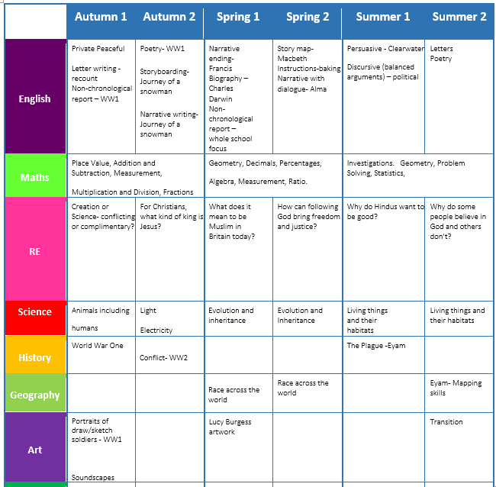

Slide 9
