Slide 1
St Thomas’ CE Primary School
Welcome to Year Four!
Please sign the Local Visits letter and return them to your class teacher.
Learning and Growing in the sight of God

Slide 2
St Thomas’ CE Primary School
Welcome!
We aim to answer any questions that you may have about our daily timetable and the Year Four curriculum.
Year 4 teachers:
Mrs Shaw, Mr Powell, Miss McGuire
Year 4 TAs:
Mis Emanuel (Y4VS + Y4MP) and Mrs Potts (Y4BM)
Learning and Growing in the sight of God

Slide 3
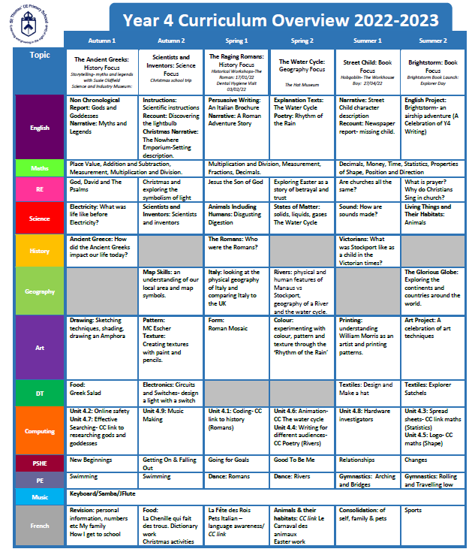
St Thomas’ CE Primary School
Learning and Growing in the sight of God

Slide 4
St Thomas’ CE Primary School
Homework:
Given out on Fridays, to be returned on Wednesdays.
Children are to complete their homework in their Homework Book (stick any worksheets in) this is a grid of topic activities; your child may pick the activity that they wish.
CGP Maths book. Please date and sign homework.
A spelling Investigation.
Children need to learn the Multiplication Facts up to 12x12.
Please feel free to comment in your child’s Homework Book or on Class Dojo on how your child has found the homework task.
Learning and Growing in the sight of God

Slide 5
St Thomas’ CE Primary School
Reading:
It is essential that children bring their reading books to school each day.
The Class Teacher/ Miss Emanuel/Mrs Potts will listen to your child read within a guided reading session each week.
Guided reading will be a daily taught session.
Children will be given a new band book once a week.
Children will also have a library book – the children can access the school library twice a week (Tuesday and Thursday).
Please support your child by encouraging them to read on a daily basis, for a minimum of 15 minutes. The children should complete the date and pages read in their reading diaries.
Learning and Growing in the sight of God

Slide 6
St Thomas’ CE Primary School
Swimming:
Children will participate in weekly swimming lessons until Christmas, these
will occur on Tuesday (4MP) and Thursday (4VS and 4BM).
Children with longer hair need to wear a swimming cap. Swim wear should be fitted.
It is essential that children remember their swimming kit for their swimming lesson. Swimming is not optional.
If your child is unable to swim due to illness, please send a written letter addressed to their Class Teacher.
DO NOT get your child’s ears pierced between now and Christmas.
Learning and Growing in the sight of God

Slide 7
St Thomas’ CE Primary School
PPA arrangements:
As last year, the class will have French lessons taught by Madame Taylor, PSHE by Mrs Mclaren and games lessons taught by a sports coach. These will be on Thursday afternoons.
Learning and Growing in the sight of God

Slide 8
St Thomas’ CE Primary School
PE and Games:
If your child has Games on a Thursday, they should come to school that day in their outdoor kit.
The children will have indoor PE (dance and gymnastics) during the Spring and Summer Terms.
Please ensure your child has the correct PE kit.
All kit should be clearly named. Kits will be kept in school at all times and will be sent home at the end of each half term.
Learning and Growing in the sight of God

Slide 9
St Thomas’ CE Primary School
Please ensure your child has the correct kit:
Navy blue shorts
Navy blue jogging pants
White t-shirt
Navy blue sweatshirt or jumper- no hoods or logos
Trainers
Waterproof coat
In winter please ensure that your child is kitted out accordingly.
Learning and Growing in the sight of God

Slide 10
St Thomas’ CE Primary School
Communication:
Information from your class teachers will be sent home via e-mail, Class Dojo and/or letter.
If you want to speak to your child’s Class Teacher personally or need to discuss a matter at length then please phone school or Dojo the class teacher to arrange an appointment.
Learning and Growing in the sight of God

Slide 11
St Thomas’ CE Primary School
Class Dojo:
To be used as a reward for children’s good behaviour.
Can be used to message class teacher with queries/ questions.
Also…
We are launching the St Thomas’ Way whereby all staff can reward the children (in and out of the classroom) with a special token.
Learning and Growing in the sight of God

Slide 12
St Thomas’ CE Primary School
Year 4 Events – book the date:
Trip to MOSI – Autumn 2
Junior Carol Service – Tuesday 13th December @7pm
Cinema Trip - TBC
Roman Day – Spring 1
PGL – Wednesday 26th – Friday 28th April
Please check the School website regularly for information about School events.
Learning and Growing in the sight of God

Slide 13
St Thomas’ CE Primary School
Holidays:
If you would like to request time off for your child during term time, you must seek permission from Ms Loynes. Request forms can be found in the office.
Learning and Growing in the sight of God

Slide 14
St Thomas’ CE Primary School
We look forward to a wonderful year with your children.
Thank you for coming.
Are there any questions we can answer?
Learning and Growing in the sight of God

