Slide 1
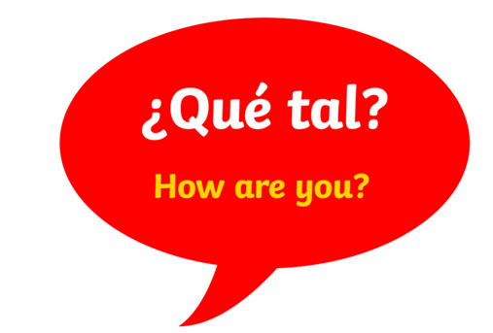
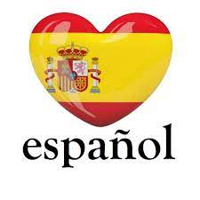
Some facts about Spanish
Spanish is the mother tongue of at least 400 million people worldwide, making it the second most widely spoken language in the world.
Which is the number one language? (it’s NOT English!)
Spanish is the official language in 21 countries, not just Spain!
Spanish has Latin origins
Spanish is a Romance language, like French and Italian but is also influenced by Arabic
Note the special accent on the ‘n’: this is called a tilde and gives the n a ‘ny’ sound. Other examples:
Señor
España
niño
What do you notice about exclamation marks (!) and question marks (?) in written Spanish?

