Slide 1
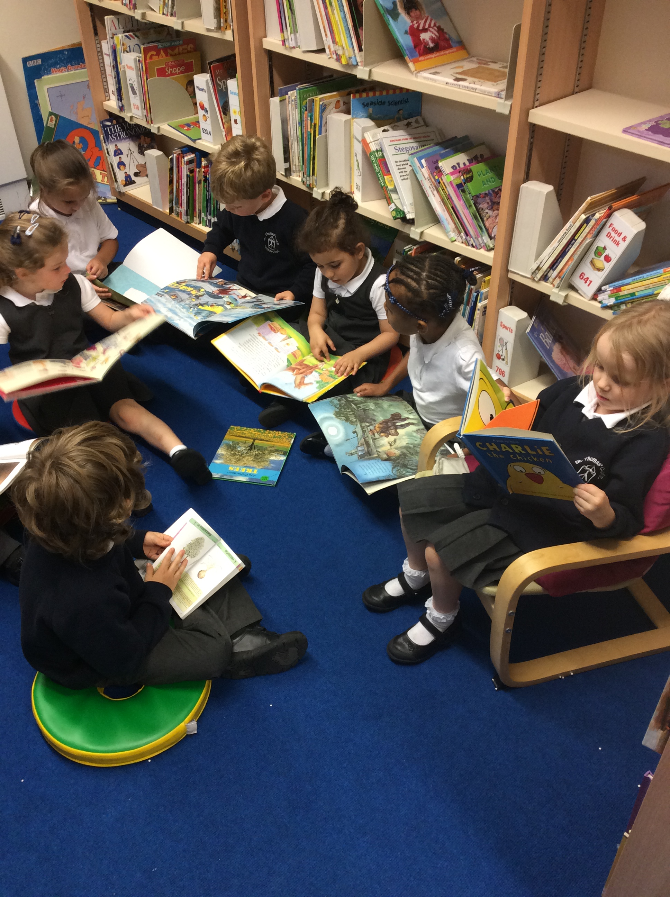
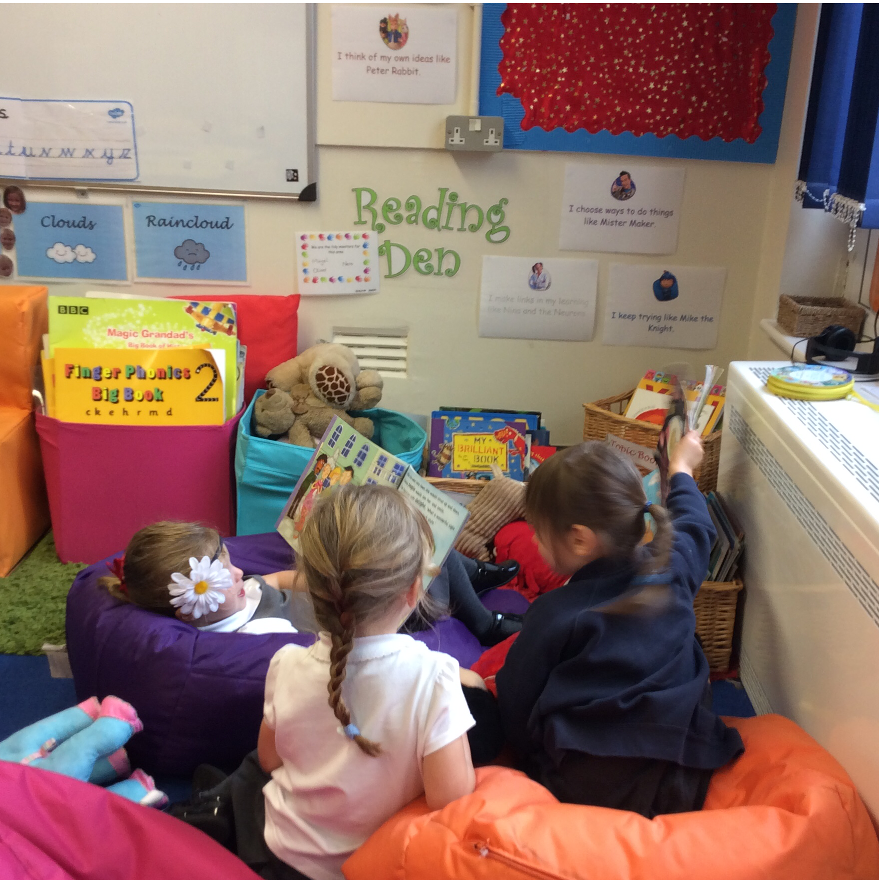
EYFS Reading Presentation
October 2021

Slide 2
Expectations
At the start of life in Reception:
Rhyming words
Initial sounds of words
Recognise print in the environment
By the end of the year:
“Children can say a sound for each letter in the alphabet and at least 10 digraphs. Read words consistent with their phonic knowledge by sound-blending. Read aloud simple sentences and books that are consistent with their phonic knowledge, including some common exception words”- Development Matters.

Slide 3
Your child’s pack
Phase 2 and Phase 3 sound mat
Precursive writing mat to help support how your child is taught letter formation at school
Early Learning Goals
Footprints
Home school reading record with a sticker highlighting their reading day
Reading book

Slide 4
How do we get there?
Library visits
Inviting Reading Areas in the classroom
‘Letters and Sounds’ taught through daily phonics
Reading in school (currently 1-1)
Guided Reading in school
Reading at home

Slide 5
Footprints
Please do not write on them. The teacher will record on these every time your child has read them correctly.
New Footprints are added as soon as your child has learnt the words.
Some of the footprints will be tricky words, eg; to, go, I. And some of the footprints will be decodable.
Have fun with the footprints. Have a word hunt around the house!

Slide 6
Phonics: Phase 1
Environmental sounds
Instrumental sounds
Body Percussion
Rhythm and Rhyme
Alliteration
Voice Sound
Oral blending and Segmenting

Slide 7
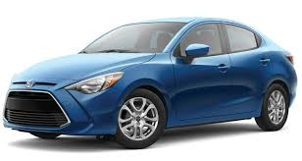
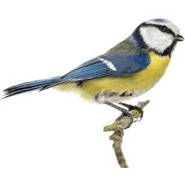
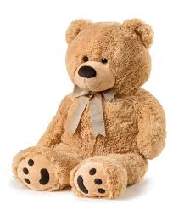
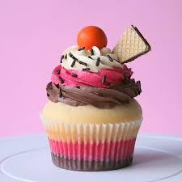
Phase 1 home activities
Listen to sounds in the environment
What can you hear?
Instrument sounds and body percussion
Play with sounds. Make a sound pattern, can they repeat it back to you? Can they make their own sound pattern?
Rhythm and Rhyme
Sing nursery rhymes, share rhyming books, rhyming soup.
Alliteration
Name their toys using alliteration
Oral blending and segmenting
Cooking ask for all the ingredients using sound talk.

Slide 8
Phonics: Phase 2
Teach individual letter sounds
C and V are abbreviations for ‘consonant’ and ‘vowel’. VC words are words consisting of a vowel then a consonant (e.g. am, at, it)
CVC words are words consisting of a consonant then a vowel then a consonant (e.g. cat, rug, sun).
Sound Buttons
c a t
Introduced to ‘tricky words’

Slide 9
Phonics: Phase 2
Your child will be taught how to pronounce the sounds (phonemes) correctly to make blending easier.
Sounds should be sustained where possible (e.g. sss, fff, mmm) and, where this is not possible, ‘uh’ sounds after consonants should be reduced as far as possible (e.g. try to avoid saying ‘buh’, ‘cuh’). Teachers help children to look at different letters and say the right sounds for them.
https://www.youtube.com/watch?v=-ksblMiliA8

Slide 10
Phonics: Phase 2
Learning our Letters & Sounds: order of letters

Slide 11
Phonics: Phase 3
The purpose of this phase is to:
Teach more graphemes, most of which are made of two letters, for example, ‘oa’ as in boat
Practise blending and segmenting a wider set of CVC words, for example, fizz, chip, sheep, light
Learn all letter names and begin to form them correctly
Read more tricky words and begin to spell some of them
Read and write words in phrases and sentences.

Slide 12
Phonics: Phase 3
CVC words containing graphemes made of two or more letters
Digraph- a combination of two letters representing one sound, as in ‘oa’ and ‘ee’
g oa t
Trigraph- a single sound that is represented by three letters, for example: ‘igh’ in the word ‘tight’ or ‘ear’ in the word ‘dear’
l igh t

Slide 13
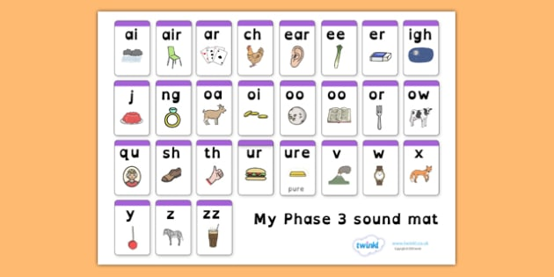
Phonics: Phase 3
Learning our Letters & Sounds: order of letters

Slide 14
Phonics: Phase 4
Children continue to practise previously learned graphemes and phonemes and learn how to read and write:
CVCC words: tent, damp, toast, chimp
and CCVC words: swim, plum, sport, spoon
They will be learning more tricky words and continuing to read and write sentences together.

Slide 15
Useful Phonics Websites
Jolly Phonics Songs: You Tube
https://www.youtube.com/watch?v=bvRKcch4DyE
http://www.teachyourmonstertoread.com/
http://www.phonicsplay.co.uk/
https://www.oxfordowl.co.uk/
www.ictgames.com/literacy
YouTube Mr Thorne and Geraldine

Slide 16
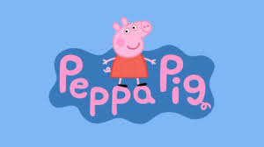
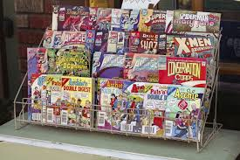
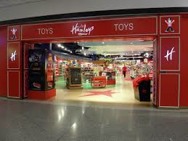
Remember…!
Reading can happen EVERYWHERE!

Slide 17
Thank you for listening

