Slide 1
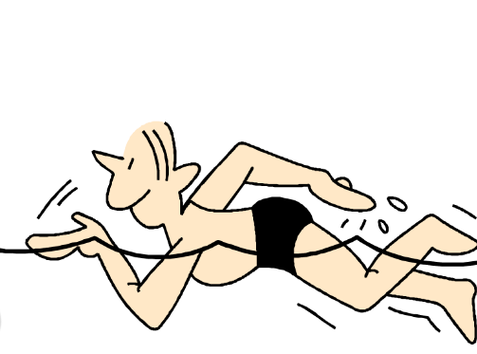
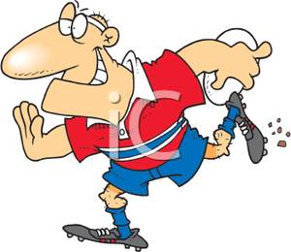
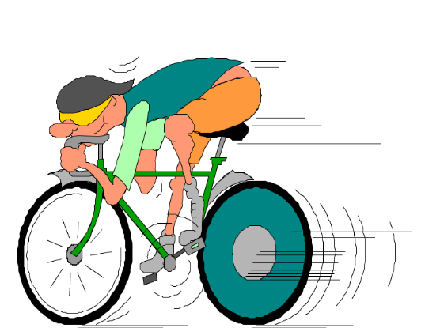
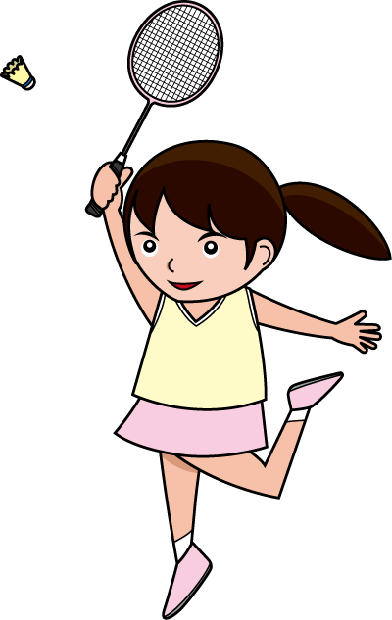
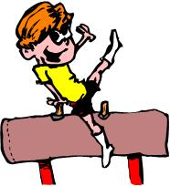
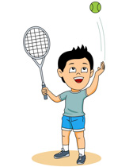
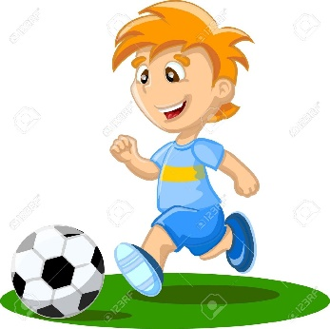
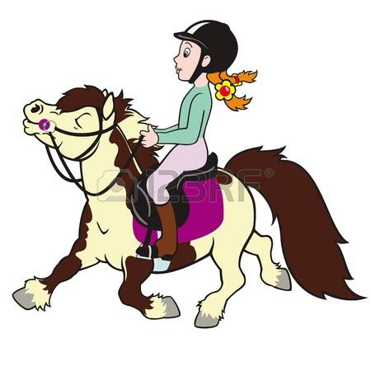
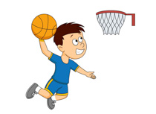
Les sports
le rugby
la natation
le cyclisme
le badminton
la gymnastique
le foot
le tennis
J’aime ...
Je n’aime pas ...
le basket
l’équitation

Slide 2
Practise making sentences...
J’aime |  | Je n’aime pas
le football
le rugby
la gymnastique
la natation
l’équitation
le badminton
le basket
le cyclisme
le tennis

Slide 3
Summer 2021 has seen lots of exciting sports events including…
le cyclisme (Tour de France)
le tennis (Wimbledon)
le football (Euro 2020)
What is coming next?

Slide 4
The Olympic games will begin on Friday 23rd July.
They take place in Tokyo,
the capital of Japan.
https://www.youtube.com/watch?v=H7ILmvOx6zY

Slide 5
du 23 juillet au 8 août 2021

Slide 6
Où se déroulent les Jeux Olympiques cet été?
Where are the Olympic Games taking place this summer?
à Tokyo, au Japon

Slide 7
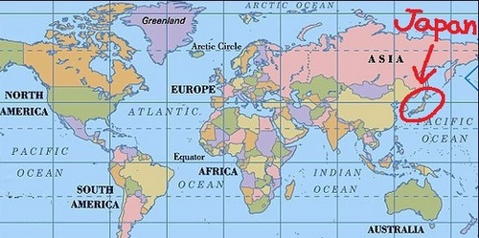
Tokyo, au Japon
The 2020 Tokyo Olympics were postponed until 2021 because of COVID.
French people refer to the Olympics as ‘Les Jeux Olympiques’ (the Olympic Games) or simply as ‘Les J.O.’

Slide 8
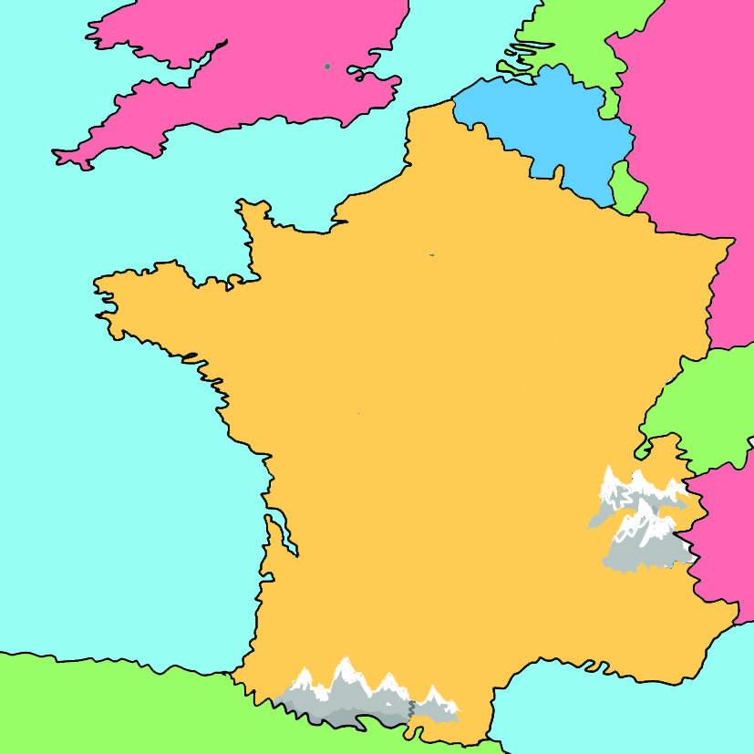
Le JO en France et en Angleterre
Les JO de 1908, 1948 et 2012:
Londres
et en 1900 et 1924: Paris
Et en 2024….
Londres
Paris

Slide 9
les Jeux Olympiques seront à Paris!

Slide 10
How many different sports will be in the Olympics this year?
How many athletes will go to Tokyo?
Avec 33 sports et plus de 11 000 athlètes, les Jeux Olympiques de Tokyo seront la destination numéro un de la planète sport cet été.
Cette année cinq sports font leur entrée à Tokyo : le karaté, le surf, le skateboard, l'escalade et le baseball/softball.
How many new sports are going to be in the Tokyo Olympics?
Let’s see what they are...

Slide 11
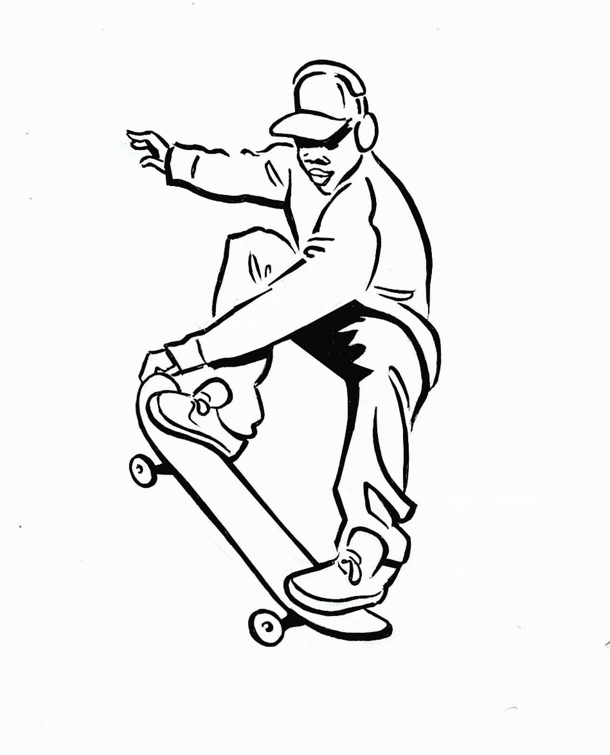
le skateboard

Slide 12
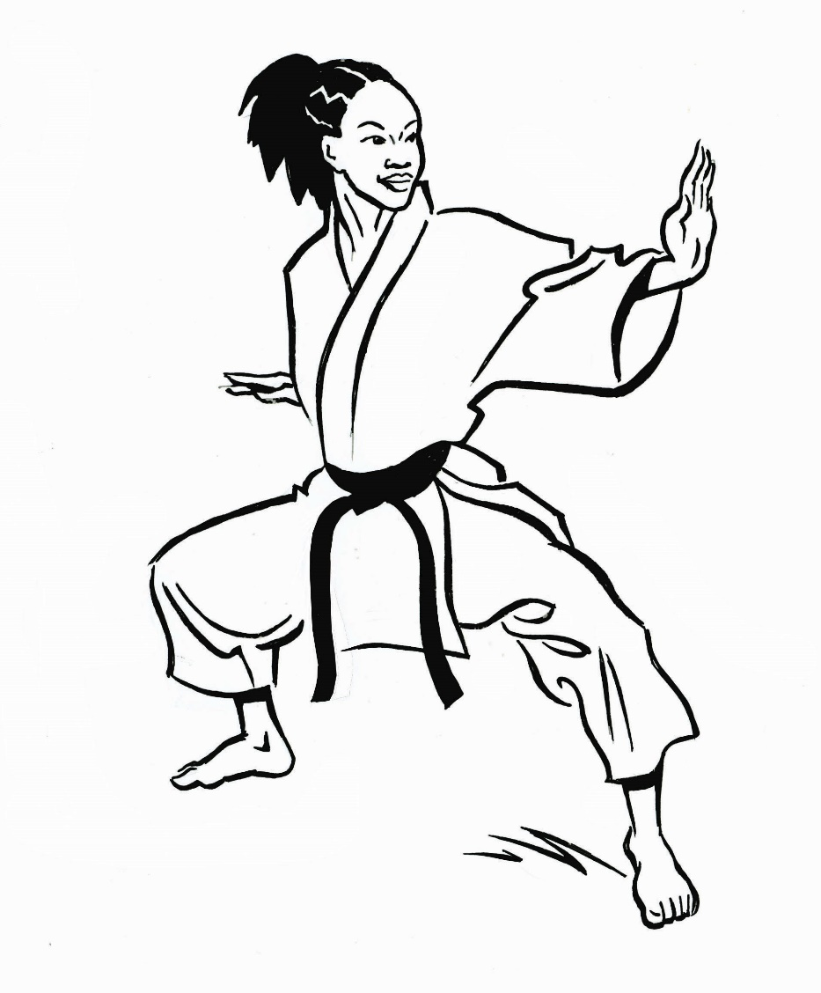
le karaté

Slide 13
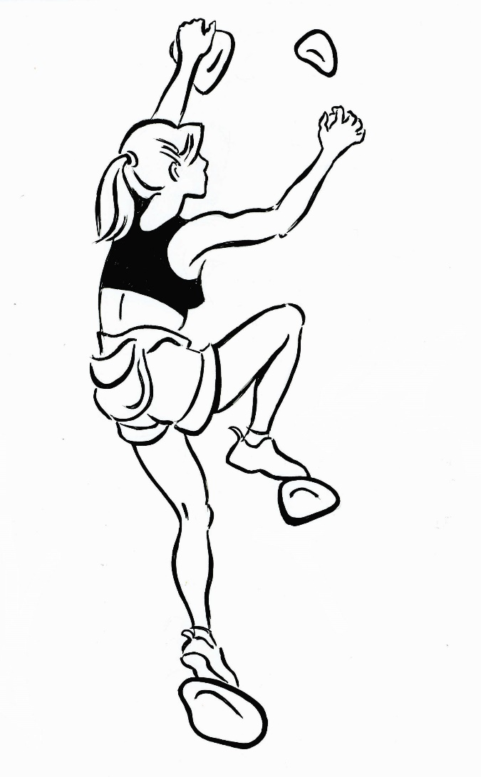
l’escalade sportive

Slide 14
le baseball (le softball)

Slide 15
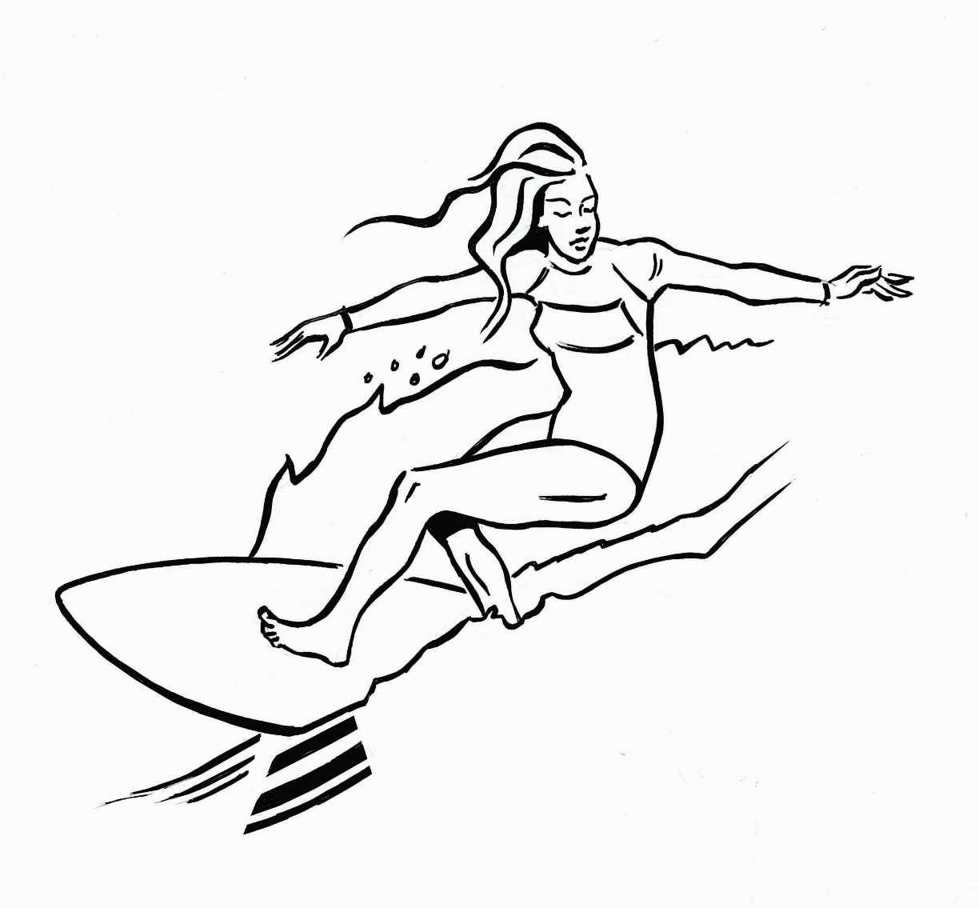
le surf

Slide 16
Les Jeux Paralympiques
After the main games end the Paralympics will begin..
du 24 août au 5 septembre
Follow this link to find out about the Paralympic sports:
https://olympics.com/tokyo-2020/fr/paralympiques/sports/one-minute-one-sport-paralympics

Slide 17
This year the Paralympic Games will have 2 new sports:.

Slide 18
le badminton

Slide 19
le taekwondo

Slide 20
Will you watch the Olympics and Paralympics this summer?
You will see lots of famous sportspeople taking part, including people from around the Greater Manchester area, for example…

Slide 21
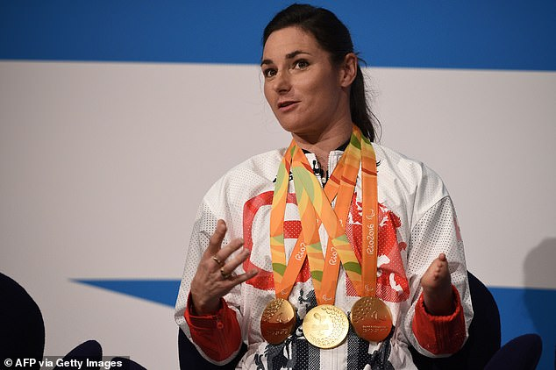
Who is this famous and record-breaking Paralympian who lives in Disley?
(Disley is just outside Stockport)

Slide 22
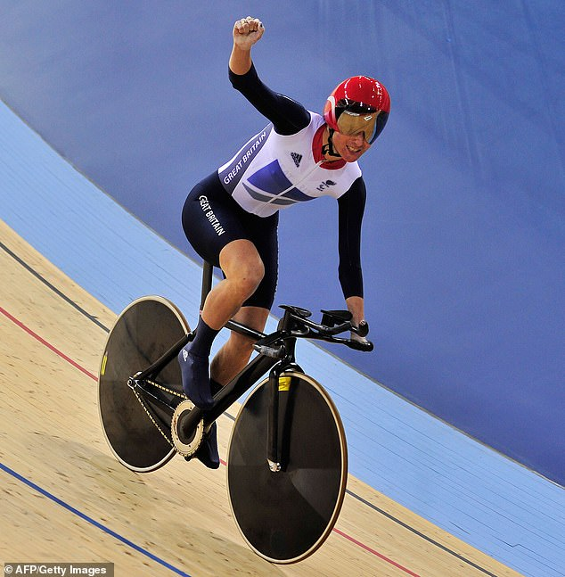
Elle s’appelle Sarah Storey.
She has won an incredible 14 gold medals in swimming and cycling. Tokyo will be her 8th Paralympics.

Slide 23
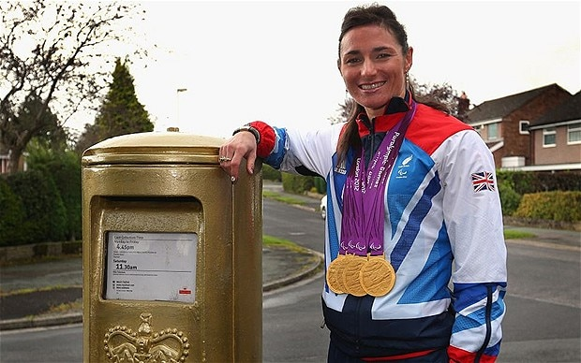
Have you ever seen the gold post box which was painted in her honour after her success at the London Olympics in 2012?

Slide 24
https://www.educandy.com/site/resource.php?activity-code=c47f4

Slide 25
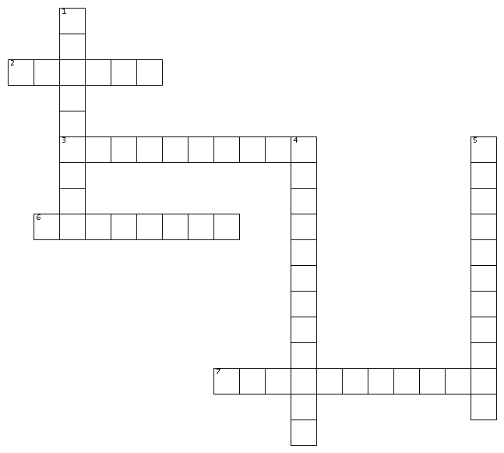
New sports at the Tokyo Olympics and Paralympics
New sports at the Tokyo Olympics and Paralympics
HORIZONTALEMENT 2. le surf 3. le baseball 6. le karaté 7. le taekwondo VERTICALEMENT 1. l'escalade 4. le skateboard 5. le badminton
HORIZONTALEMENT 2. le surf 3. le baseball 6. le karaté 7. le taekwondo VERTICALEMENT 1. l'escalade 4. le skateboard 5. le badminton

Slide 26
New sports at the Tokyo Olympics and Paralympics
HORIZONTALEMENT 2. le surf 3. le baseball 6. le karaté 7. le taekwondo VERTICALEMENT 1. l'escalade 4. le skateboard 5. le badminton

