Slide 1
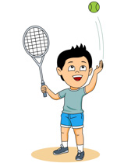
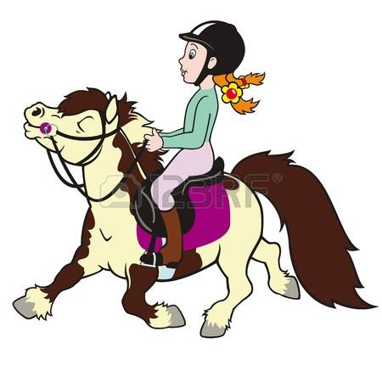
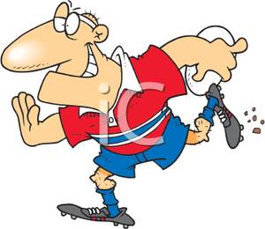
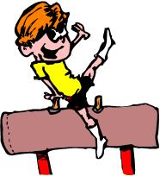
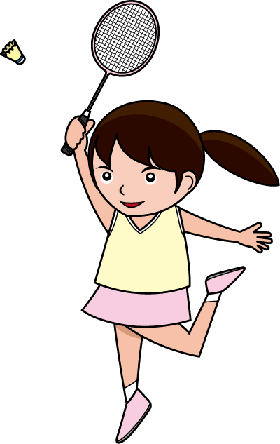
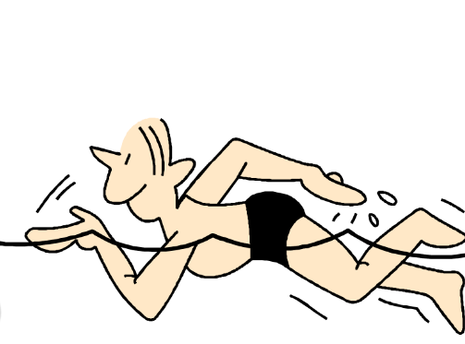
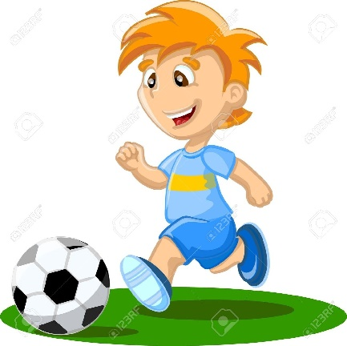
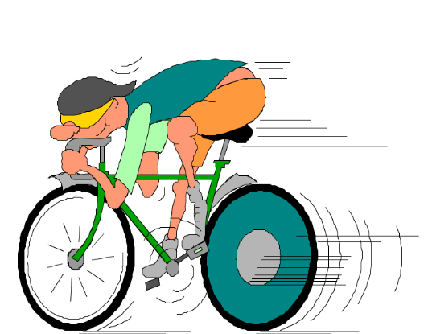
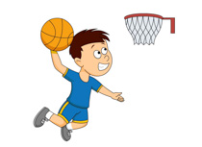
Les Sports

Slide 2
Les sports
le rugby
la natation
le cyclisme
le badminton
la gymnastique
le foot
le tennis
J’aime ...
Je n’aime pas ...
le basket
l’équitation

Slide 4
Les sports
le rugby
la natation
le cyclisme
le badminton
la gymnastique
le foot
le tennis
J’aime ...
Je n’aime pas ...
le basket
l’équitation

Slide 5
J’aime ...
Je n’aime pas ...
To say you like a sport use ‘j’aime’; to say you don’t like a sport use ‘je n’aime pas’.

Slide 6
Practise making sentences...
J’aime |  | Je n’aime pas
le football
le rugby
la gymnastique
la natation
l’équitation
le badminton
le basket
le cyclisme
le tennis

Slide 7
Making even more interesting sentences...
I like football. I don’t like rugby.
If we used a conjunction these sentences could be more interesting – eg
I like football but I don’t like rugby.
Use some of the following conjunctions to make more interesting sentences!
et = and
mais = but
pourtant = however
Here’s an example.
J’aime le foot et le rugby mais je n’aime pas le tennis.
I like football and rugby but I don’t like tennis.

Slide 8
Some more sports...
Watch the following clip and learn some more sports in French.
https://www.youtube.com/watch?v=LCEPGU63P1M

Slide 9
educandy
Try playing games on educandy:
https://www.educandy.com/site/resource.php?activity-code=151e
and
https://www.educandy.com/site/resource.php?activity-code=23fec
for some more difficult sports!

Slide 10
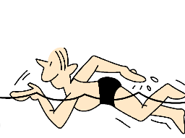
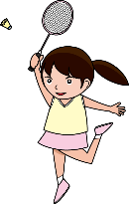
Les sports
Find the sports in the wordsearch
J | E | E | L | O | N | C | I | S | K | L | N
O | T | M | J | E | F | F | I | N | E | Y | O
D | W | U | S | Y | R | N | T | B | A | L | I
X | P | B | Z | I | N | U | A | Q | S | E | T
B | C | Z | U | E | L | D | G | R | A | F | A
Z | P | B | T | R | M | C | C | B | O | O | T
O | E | E | V | I | Y | A | Y | L | Y | O | A
O | L | I | N | B | R | S | N | C | B | T | N
K | V | T | L | E | B | A | S | K | E | T | A
N | O | I | T | A | T | I | U | Q | E | L | L
N | L | M | M | J | S | M | U | P | T | M | S
C | M | V | I | O | K | H | J | Q | D | M | Y
le badminton le basket le tennis
le rugby le cyclisme le foot
la gymnastique la natation l’équitation

Slide 11
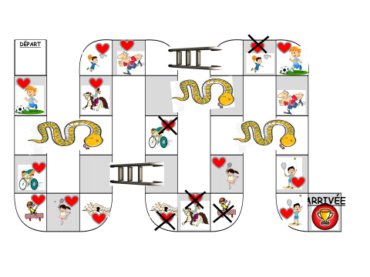
Try playing this snakes and ladders game with someone at home! When you land on a square you have to say the correct phrase eg the first one is ‘J’aime le foot’.

