Slide 1
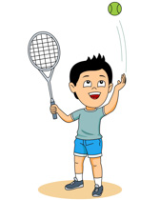
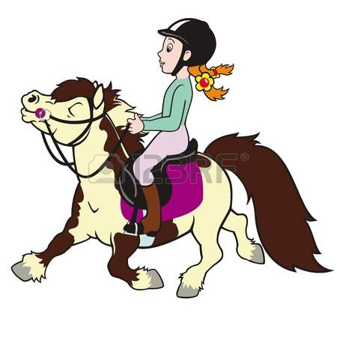
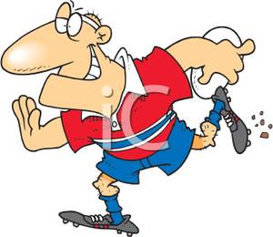
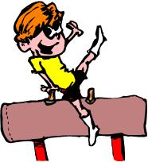
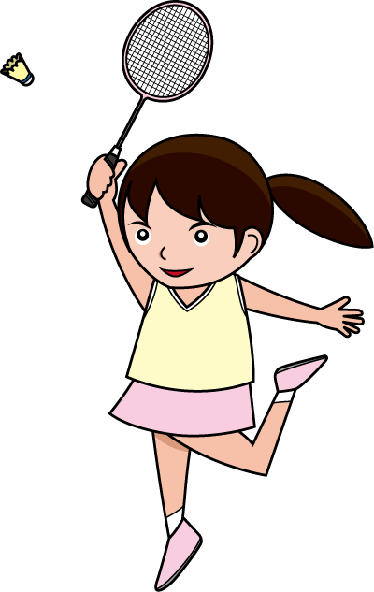
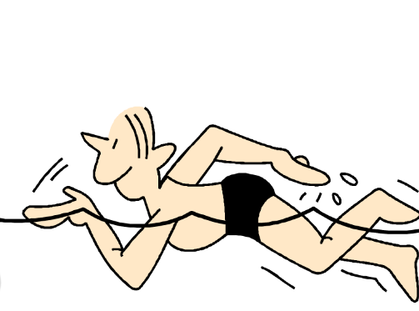
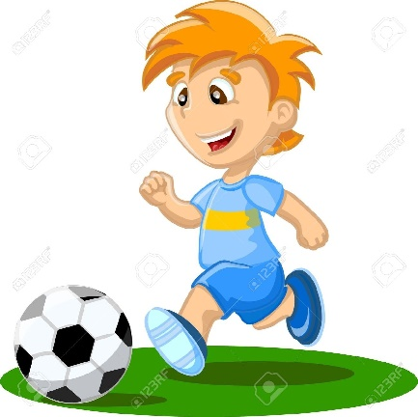
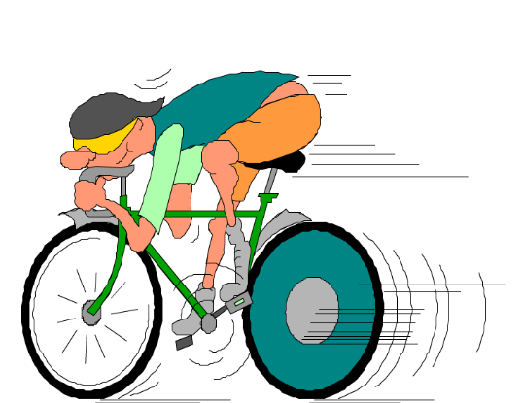
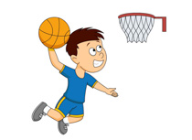
Les Sports

Slide 2
Les sports
le rugby
la natation
le cyclisme
le badminton
la gymnastique
le foot
le tennis
J’aime ...
Je n’aime pas ...
le basket
l’équitation

Slide 4
Les sports
le rugby
la natation
le cyclisme
le badminton
la gymnastique
le foot
le tennis
J’aime ...
Je n’aime pas ...
le basket
l’équitation

Slide 5
J’aime ...
Je n’aime pas ...
To say you like a sport use ‘j’aime’; to say you don’t like a sport use ‘je n’aime pas’.

Slide 6
Practise making sentences...
J’aime |  | Je n’aime pas
le football
le rugby
la gymnastique
la natation
l’équitation
le badminton
le basket
le cyclisme
le tennis

Slide 7
Making even more interesting sentences...
I like football. I don’t like rugby.
If we used a conjunction these sentences could be more interesting – eg
I like football but I don’t like rugby.
In French there are several conjunctions we can use:
et = and
mais = but
pourtant = however
Try to make up some interesting sentences of your own.

Slide 8
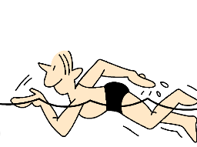
Les sports
Find the sports in the wordsearch
J | E | E | L | O | N | C | I | S | K | L | N
O | T | M | J | E | F | F | I | N | E | Y | O
D | W | U | S | Y | R | N | T | B | A | L | I
X | P | B | Z | I | N | U | A | Q | S | E | T
B | C | Z | U | E | L | D | G | R | A | F | A
Z | P | B | T | R | M | C | C | B | O | O | T
O | E | E | V | I | Y | A | Y | L | Y | O | A
O | L | I | N | B | R | S | N | C | B | T | N
K | V | T | L | E | B | A | S | K | E | T | A
N | O | I | T | A | T | I | U | Q | E | L | L
N | L | M | M | J | S | M | U | P | T | M | S
C | M | V | I | O | K | H | J | Q | D | M | Y
le badminton le basket le tennis
le rugby le cyclisme le foot
la gymnastique la natation l’équitation

Slide 9
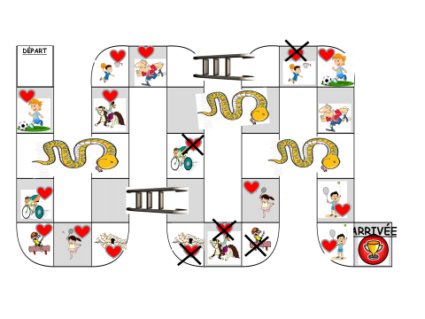
Try playing this snakes and ladders game with someone at home! When you land on a square you have to say the correct phrase eg the first one is ‘J’aime le foot’.

Slide 10
educandy
Try playing games on educandy:
https://www.educandy.com/site/resource.php?activity-code=151e

