Slide 1
Lesson 7 – The Underground Railroad

Slide 2
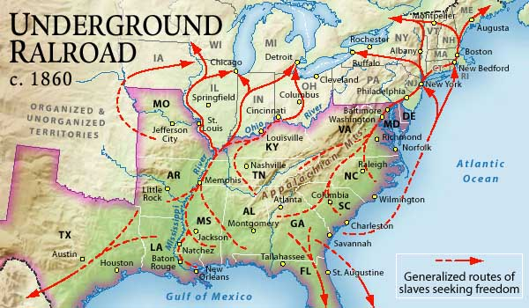
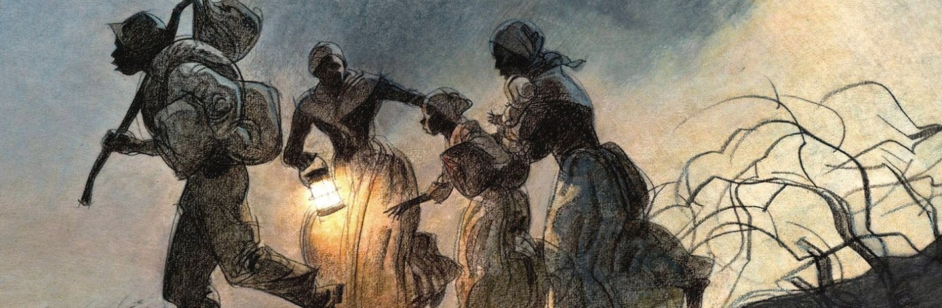
What would you guess the Underground Railroad was?

Slide 3
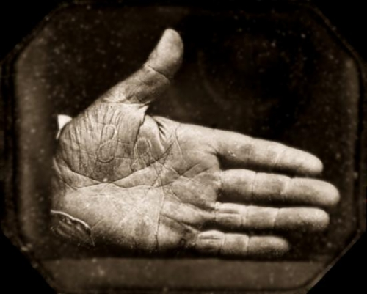
If a slave ran away from their owner he or she was very likely to be recaptured unless they had help. Slave owners often chained slaves up, branded them with specific marks, made them wear certain clothes or did something similar to make them stand out.
The Underground Railroad grew during the 1800s. 'Free' slaves, both those who escaped and those who were set free, joined together to help other slaves escape. It was a dangerous and illegal action, but it offered hope to those who had no other way of escape.

Slide 4
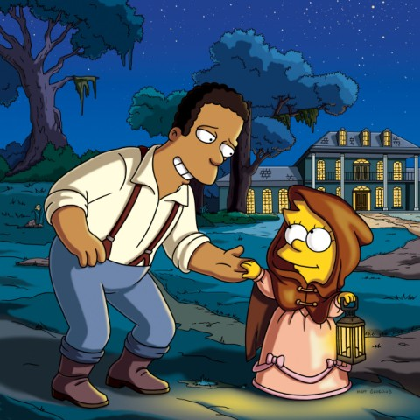
The Underground Railroad was neither underground or a railroad, but a secret network of safe houses and antislavery activists - black, white, and Native American - who helped slaves escape to freedom.

Slide 5
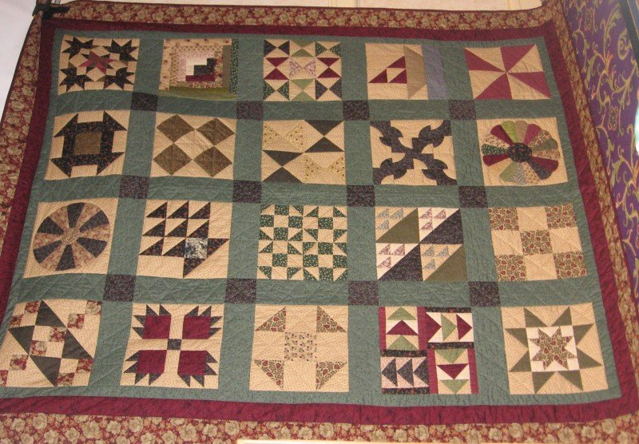
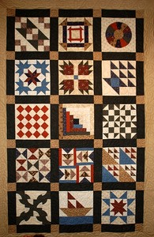
What could these shapes and patterns have to do with the Underground railroad?

Slide 6
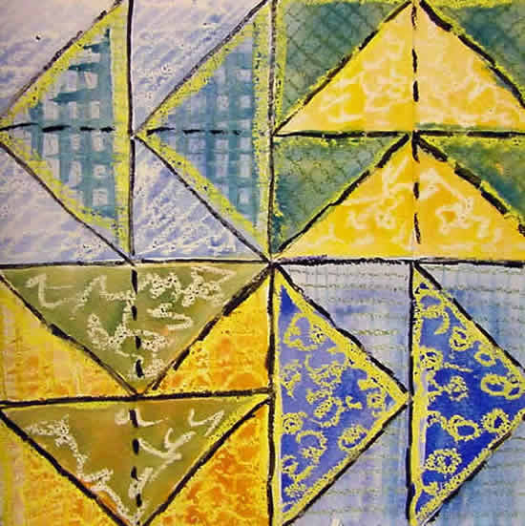
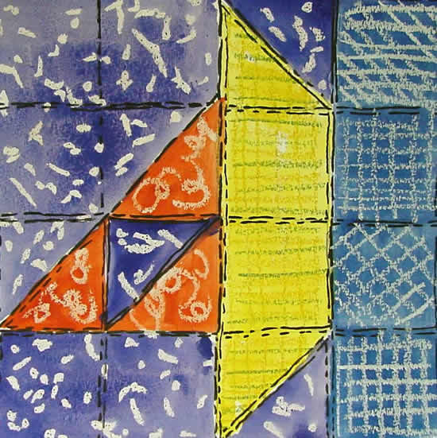
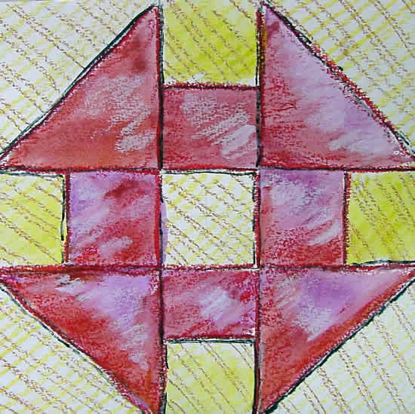
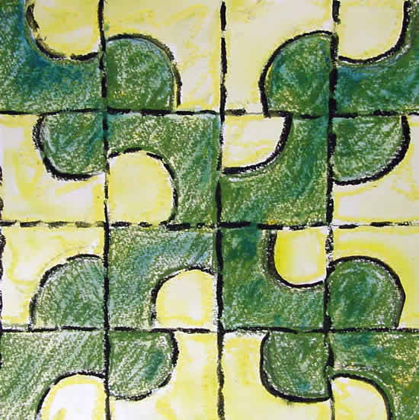
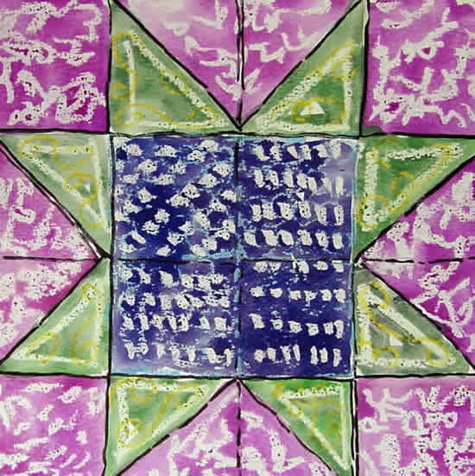
“Sailboat” – there is water nearby or boats to escape
“Flying Geese” – follow the geese as they fly north
“Monkey Wrench” – signal to gather tools for the journey
“Winding path” – a warning sign to take a zigzag path
“North Star” – be ready to escape and follow the north star

Slide 7
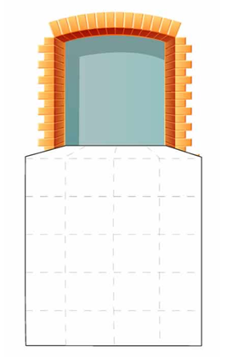
Task:
Design your own quilt using the codes of the underground railroad, to warn runaway slaves and give them instructions.
Bright Sparks
On a blank piece of A4, create your own underground railroad code to send a secret message to a runaway slave.

Slide 8
“Flying Geese” –
“Sailboat”
“Monkey Wrench”
“North Star”
“Winding path”

Slide 9
How’re we doing with our topic objectives?
To know the size of the British Empire,
To understand the three points of the “Triangular Trade”,
To explore the experiences that slaves had,
To investigate why slavery was abolished and the part played by the Underground Railroad

